Slide 1













CAPSTONE PROJECT
Final Project - online food orders feedback prediction using rnn
Presented By
Guru Prasath D
711721244021
III Btech CSBS
KGISL Istitute Of Technology
3/21/2024 Annual Review
1

Slide 2




PROJECT TITLE
Recurrent Neural Networks for Feedback Forecasting: Improving Online Food Ordering Experiences
3/21/2024 Annual Review
1

Slide 3




AGENDA
1. Problem Statement
2. Project Overview
3. End Users
4. Solution and Value Proposition
5. The Wow Factor in Your Solution
6. Modelling
7. Results
3/21/2024 Annual Review
3

Slide 4

PROBLEM STATEMENT
The precision and reliability of current online food feedback prediction methods are lacking, which poses a serious challenge to food sector enterprises that depend on reliable feedback analysis.
Prediction errors can cause ineffective resource allocation, a decline in client satisfaction, and difficulties growing a business.
3/21/2024 Annual Review
4

Slide 5

PROJECT OVERVIEW
Our project's goal is to build a cutting-edge time series prediction model with a focus on online meal order feedback trend forecasting.
Our main objective is to provide accurate and trustworthy feedback projections to support decision-making in the online food sector by utilising state-of-the-art machine learning techniques.
Our goal is to provide stakeholders with an effective means of improving customer happiness, operational effectiveness, and strategic decision-making in response to changing feedback dynamics through comprehensive data analysis, model refinement, and validation.
3/21/2024 Annual Review
4

Slide 6

WHO ARE THE END USERS?
1. Restaurants and online food platforms: To improve services, streamline menus, and raise consumer satisfaction levels, these businesses rely on precise feedback forecasts.
2. Customer Support and Delivery Staff: By using feedback forecasts, customer service and delivery staff can foresee and resolve possible problems, guaranteeing smooth order deliveries and client interactions.
3/21/2024 Annual Review
4

Slide 7

YOUR SOLUTION AND ITS VALUE PROPOSITION
Our approach uses sophisticated recurrent neural networks (RNNs) to reliably predict feedback from online meal orders.
Our methodology creates actionable insights to improve service quality and customise offerings by analysing many aspects such as order information and client profiles.
This method enables companies to improve client experiences, hone tactics, and maintain an advantage in the cutthroat food market.
3/21/2024 Annual Review
4

Slide 8


THE WOW IN YOUR SOLUTION
We guarantee unprecedented feedback prediction precision with our solution's stacked LSTM architecture.
Setting new benchmarks for predictive analytics, real-time integration of environmental data improves accuracy and adaptability.
Our technology transforms customer feedback methods and boosts growth and satisfaction by providing organisations with actionable insights that drive growth.
Our technology, which redefines how businesses understand and respond to feedback, is a trailblazing leap in the field of predictive analytics.
3/21/2024 Annual Review
10

Slide 9
MODELLING
We base our modelling technique on a stacked Long Short-Term Memory (LSTM) architecture, which is well known for its ability to represent temporal dependencies in sequential data.
In order to keep the model from overfitting and improve its generalisation abilities, we use dropout regularisation approaches.
Wireframes are integrated by our team collaboratively to visualise and iterate on the model design, promoting openness and efficient communication all the way through the development process.
We consistently improve the forecasting model through iterative refinement, guaranteeing strong performance and dependability in predicting online food order feedback.
3/21/2024 Annual Review
10

Slide 10
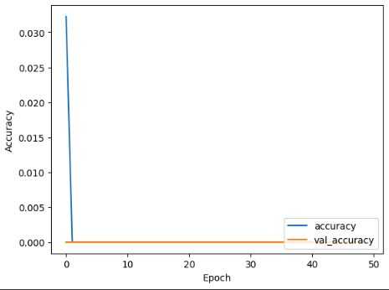
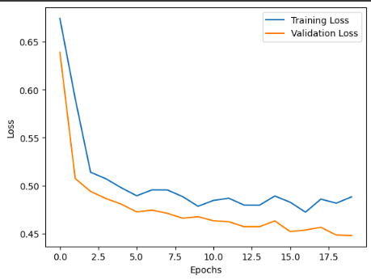
RESULTS
Demo Link
3/21/2024 Annual Review
10

